Slide 1


• We’ll start in a moment :) • We are NOT recording tonight’s event. We may plan to take screenshots for social media. • If you want to remain anonymous, change your name & keep video off. • We’ll introduce the hosts and break in-between for Q/A. • We will make some time for Q&A at the end of the presentation as well. • You can come prepared with questions. And, feel free to take notes. • Online event best practices: • Don't multitask. Distractions reduce your ability to remember concepts. • Mute yourself when you aren’t talking. • We want the session to be interactive. • Feel free to unmute and ask questions in the middle of the presentation. • Turn on your video if you feel comfortable. • Disclaimer: Speaker doesn’t knows everything! Check out:
• Technical Tracks and Digital Events • Get updates – join the Digital mailing list • Give us your feedback – take the Survey
Copyright © 2021 by Prachi Shah
Welcome!

Slide 2

Copyright © 2021 by Prachi Shah
WWCode Digital + Backend
Backend Study Group
July 1, 2021

Slide 3
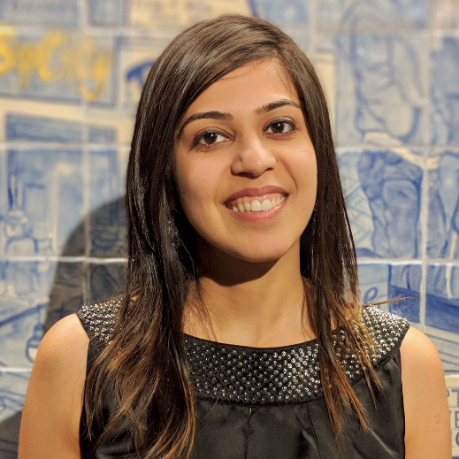
• Welcome from WWCode! • Our mission: Inspiring women to excel in technology careers. • Our vision: A world where women are representative as technical executives, founders, VCs, board members and software engineers.
• What is Backend Engineering?
• Software Design • Design Patterns • Software Design Patterns [Part 5 of 5] • Creational Design Patterns [4/22] • Structural Design Patterns [5/20] • Behavioral Design Patterns [6/3] • Anti-patterns [6/17] • Interview Questions and Q/A [7/1]
Copyright © 2021 by Prachi Shah
Introduction & Agenda
Prachi Shah
Senior Software Engineer @ Metromile

Slide 4
• What is Backend Engineering?
• Design, build and maintain server-side web applications. • Concepts: Client-server architecture, API, micro-service, database engineering, distributed systems, storage, performance, deployment, availability, monitoring, etc.
Software Design • Defining the architecture, modules, interfaces and data. • Solve a problem or build a product. • Define the input, output, business rules, data schema. • Design patterns solve common problems. • 3 Types: • UI design: Data visualization and presentation. • Data design: Data representation and storage. • Process design: Validation, manipulation and storage of data.
Copyright © 2021 by Prachi Shah
Backend Engineering

Slide 5


Copyright © 2021 by Prachi Shah
Backend Engineering
Previously, we discussed... • Prerequisites for design patterns: Basics of programming & OOP • Necessity of design patterns: • Template solutions/ shared vocabulary. • Build code on-top of a pattern solution. • Maintainability: Easy to maintain code. • Reusability: Easy to reuse code for new features. • Scaling: Large-scale reuse of architectures. • Types of design patterns: Creational, Structural, Behavioral • Solving problems using design patterns and code demos, and real-life applications. Examples: Order generation [Bridge/Structural], create different shapes [Factory/Creational], iterate over a collection [Iterator/Behavioral], etc. • Anti-patterns
You can unmute and talk or use the chat.

Slide 6
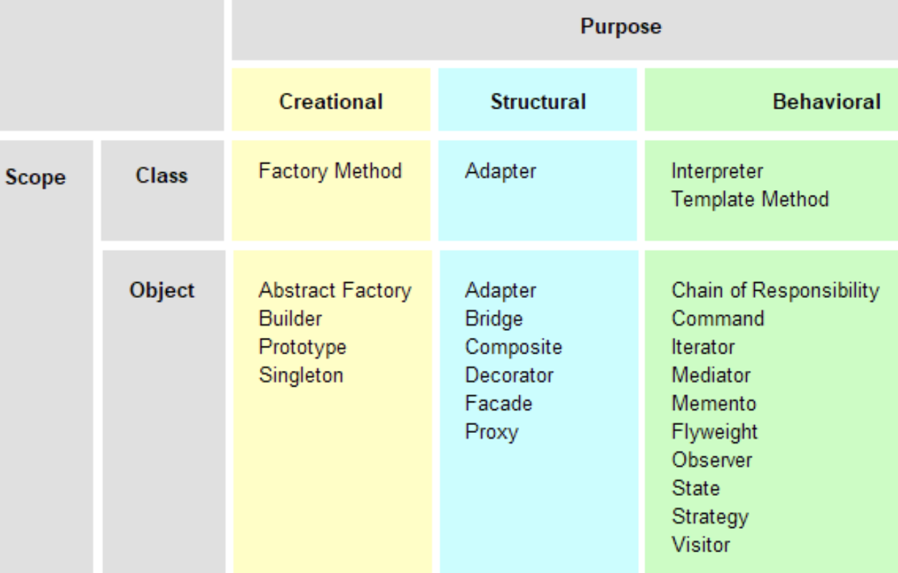
Copyright © 2021 by Prachi Shah
Backend Engineering
Design Patterns • Set of template solutions that can be reused. • Improved code maintainability, reusability and scaling. • Leverages Object-oriented programming (OOP) principles for flexible & maintainable designs. • Shared pattern vocabulary. Relationship between objects, loosely coupling, security. • Not a library or framework, but recommendations for code structuring and problem solving. • Adapt a pattern and improve upon it to fit application needs. Types of Design Patterns • Creational: • Initialize a class and instantiate the objects. • Decoupled from implementing system. • Singleton, Factory, Builder, Abstract Factory, Prototype. • Structural: • Class structure and composition. • Increase code reusability and functionality. • Create large objects relationships. • Adapter, Facade, Decorator, Bridge, Composite, Flyweight, Proxy. • Behavioral: • Relationship and communication between different classes. • Observer, Strategy, Iterator, etc.

Slide 7
Backend Engineering
Object Oriented Programming Principles: Create objects with data (attributes) & functions (methods)
Abstraction: • Hide complexity and details • Caller does not need to know the details • Each class has its own abstraction • Easy to maintain code and add features | Encapsulation: • Bundle data and methods into one unit (class) • Entity: data and operations match real-world scenario • Hide data from users • Declare attributes as private • get() and set() methods to access data • Better control over data access and methods • Improved security of data • Data can be read-only or write-only | Inheritance: • Derive a class from another class • Classes share attributes & methods • Hierarchy of super class, sub class • extends keyword • Reusability | Polymorphism: • Use same interface for different classes • is-a relationship • implements keyword • Interface has public methods without implementation • Implementing class overrides all of these methods • Implementing class provides own function/ logic
Copyright © 2021 by Prachi Shah

Slide 8
Backend Engineering
Creational Design Patterns:
Singleton: • One instance only • Instance variable is static • private constructor • Caller gets the instance from a getInstance() • Lazy initialization: Instance is created and initialized on-demand • Eager initialization: Instance is created and initialized on class load • One instance per singleton per Java Virtual Machine (JVM) • Example: Company has one CEO; University has one Proctor; Log4j logging program | Factory: • Create an object by hiding the creation logic • Use a common interface to create objects • Create a new instance on-demand and initializes fields • Reduces code duplication, provides consistent behavior • Easy to maintain classes as creation is centralized • Loosely coupled classes • Example: Uber users | Builder: • Build custom objects of a class • Objects can be different • Use the same creation logic • Seperate the construction and representation • Flexible design, readable code, complete objects • Example: Ordering food from DoorDash
Copyright © 2021 by Prachi Shah

Slide 9
Backend Engineering
Structural Design Patterns:
Adapter: • Wrapper pattern. • Incompatible objects can interact. • Object adapts to interface of another object. • Reusability of functionality. • Seperate the interface from business logic. • New adapters can be introduced for different client integrations. • Adapter: Object that connects two different interfaces.Wraps an object to hide the implementation complexity. Object can use the interface, to call adapter methods. • Example: Connect your phone to Alexa, Fitbit, Apple Watch | Bridge: • Separate abstraction from implementation. • Independent development, loosely-coupled, hierarchical and hide details. Client accesses abstraction, agnostic of implementation. • Abstraction: Interface declare operations and delegates.References the implementation. abstract class and concrete class. • Implementor: Operations are implemented.interface and concrete implementor class that implements the interface. • Example: Lyft app has driver login and rider login. | Decorator: • Modify an object’s behavior at runtime without modifying the structure. • Does not affect other object instances. • Removes need for subclassing, therefore more flexible than inheritance. • Extendible and easy to maintain code. • Decorator: Class that encapsulates concrete class to provide modified functionality. Wrapper linked to a target class. Implements the same interface as the target class. • Example: Java IO classes like FileReader.
Copyright © 2021 by Prachi Shah

Slide 10
Backend Engineering
Behavioral Design Patterns:
Chain of Responsibility: • Sender object sends request to a chain of receiving objects to eventually reach the receiver object. This avoids coupling between sender object and receiver. • Once an object independently handles the request, it is sent to the next object in the chain. • Handler: Interface that receives a request and sends it to the next handler object. • Example: Shipment delivery of packages. | Iterator: • Traverse a collection of objects in a specific manner. AKA cursor. • Access elements without revealing the implementation. • Iterator: Interface with methods to iterate over a collection (of any type). Different simultaneous iterations: one-way and bi-directional. • Example: Directory of names: Search alphabetically, search from start or from end. | Observer: • Define 1-1 dependency between objects. • On change of state in one object, dependant objects are notified and updated. • AKA broadcast communication or subscribe-publish. • Observable: Objects state change is of interest. • Observer: Registered objects that are notified on Observable’ state change. • Example: Marketing & new products notifications. Kafka Pub/Sub. | Strategy: • Select one out of different strategies/ algorithms/ implementations at runtime. • Add strategies in separate classes that the client references w.r.t. the context. Strategy: Interface with methods to implement the strategy (Example: Sorting). Run various Strategy implementations (Example: Merge, Quick, etc.). • Example: Sort algorithms a collection of objects (List, Set, etc.).
Copyright © 2021 by Prachi Shah

Slide 11
Backend Engineering
Anti-Patterns: Process or action that doesn’t solve a problem and has bad consequences.
Big Ball of Mud: • Application lacks architecture and isn’t cohesive. • Code is old/obsolete, not suitable for optimization, highly buggy, etc. • AKA Spaghetti code (unstructured code) or technical debt (need to rewrite the code). • Examples: Small set of services dependent on each other. Over time, more dependencies, more path flows, and tight coupling. | God Object: • An entity/object has many functions that complicate implementation. • Inefficient bifurcation of a large problem into smaller problems. • Tight coupling with an object for all functionalities and data. • Object exclusively stores state management. • Single point of failure. • Example: For cars, flights, hotels. | Boat Anchor: • Throw-away or obsolete code is retained. • Difficulty differentiating between working and obsolete code. • Either delete the code or mark it as deprecated, or move/isolate the code. • Examples: Poor/no documentation, convoluted implementation, C# Obsolete attribute, Python @deprecated decorator. • A metaphor to throwing an anchor in the water. | Hard Coding: • Embedding data into the program instead of fetching at runtime. • Any change in values requires source code changes, recompilation and retesting. • End-user or downstream system needs to be made aware of the changes. • Backdoor: Security concern if hard-coded credentials. • Magic number/string: If hard-coded value is repeated then it is hard to update instances.
Copyright © 2021 by Prachi Shah

Slide 12
Copyright © 2021 by Prachi Shah
Backend Engineering
Common Interview Questions: • What is a design pattern? Why use patterns? What are the benefits? • What are the types of design pattern? Can you give examples? • Can you solve a problem using a design pattern? If yes, what pattern(s) will you use and why?
• What are anti-patterns? Can you give examples?
Coding Problems: • Design DoorDash order management? What design pattern(s) will you use and why?
• Design Uber user management? What design pattern(s) will you use and why?
• Design a TrackMyHealth app? What design pattern(s) will you use and why? • Given a codebase, can you identify anti-patterns?
You can unmute and talk or use the chat.

Slide 13
• WWCode Presentation and Demo
• WWCode YouTube channel:
• March 25, 2021 session recording: Backend Engineering
• April 8, 2021 session recording: Java Microservice and REST API Demo
• April 22, 2021 session recording: Creational Design Patterns
• May 20, 2021 session recording: Structural Design Patterns • June 3, 2021 session recording: Behavioral Design Patterns
• June 17, 2021 Anti-Patterns [No recording]
• Resources:
• Software design pattern
• Design Patterns in Java • Design Patterns in Python and Ruby • Head First Design Patterns book • Anti-pattern
NEXT SESSION on 7-15-2021: Data Engineering & Data Science. Come prepared with questions!
You can unmute and talk or use the chat.
Copyright © 2021 by Prachi Shah
Backend Study Group

